Slide 1
GROUP MEMBERS
zainabaminu100@gmail.com
danieloji23@gmail.com
favourina.akpan@gmail.com
estherogedengbe123@gmail.com
adubabs0108@gmail.com
rosemaryee.ugonna@gmail.com
babajideakinyelej@gmail.com
sade.mbah@yahoo.com

Slide 2
FERTILITY RATE IN NIGERIA AND IT’S EFFECT ON GDP PER CAPITA (2023 GLOBAL POPULATION DATA)
PRESENTED TO :
POLICY MAKERS IN HEALTH, PLANNING, BUDGET AND POPULATION SECTORS OF THE NIGERIAN ECONOMY
BY ALTSCHOOL DATA ANALYSIS PROJECT GROUP 12

Slide 3
INTRODUCTION
PROJECT OBJECTIVE:
This presentation aims to determine the possible effect of Fertility Rate and Median Age on GDP per capita in Nigeria.
Draw valuable insights from outcomes of our analysis, and make useful recommendations that could positively impact Nigeria’s GDP per capita.
KEY INDICES CONSIDERED:
Global Population: Total number of humans currently living.
Fertility Rate: Average number of children that are born to a woman over her lifetime.
Median Age: The age at the midpoint of a country’s population.
Gross Domestic Product (GDP): Standard measure of the value added created through the production of goods & services in a country during a specified period of time.
GDP per capita (US$): A country’s GDP divided by it’s population, to determine economic output per head.

Slide 4
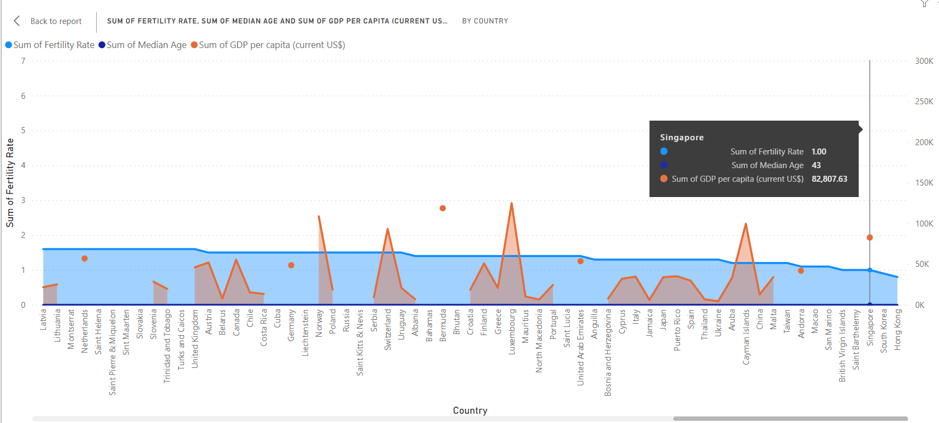
SUM OF FERTILITY RATE, SUM OF MEDIAN AGE AND SUM OF GDP PER CAPITA (HIGHEST RANKING COUNTRIES)

Slide 5
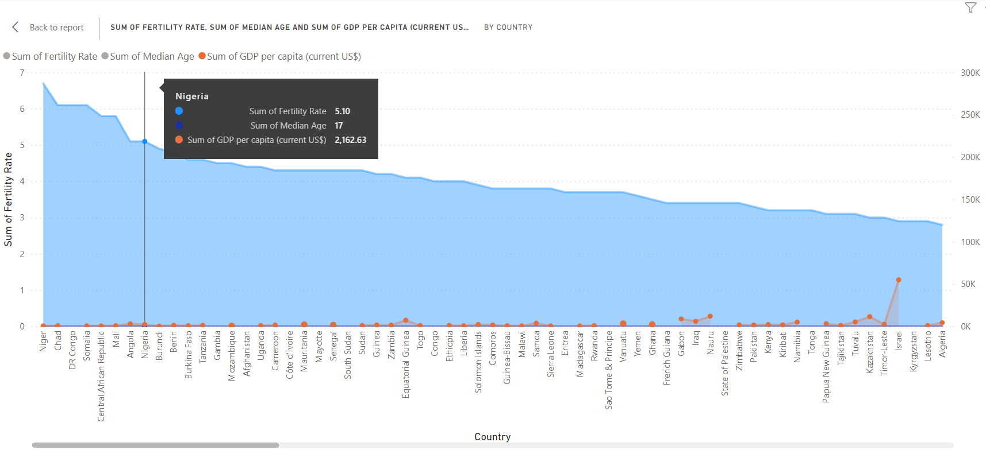
SUM OF FERTILITY RATE, SUM OF MEDIAN AGE AND SUM OF GDP PER CAPITA (LOWEST RANKING COUNTRIES)

Slide 6
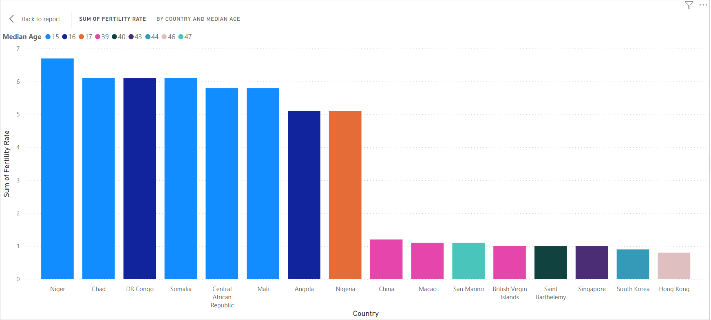
SUM 0F FERTILITY RATE BY COUNTRY & MEDIAN AGE (TOP 8 & BOTTOM 8)

Slide 7
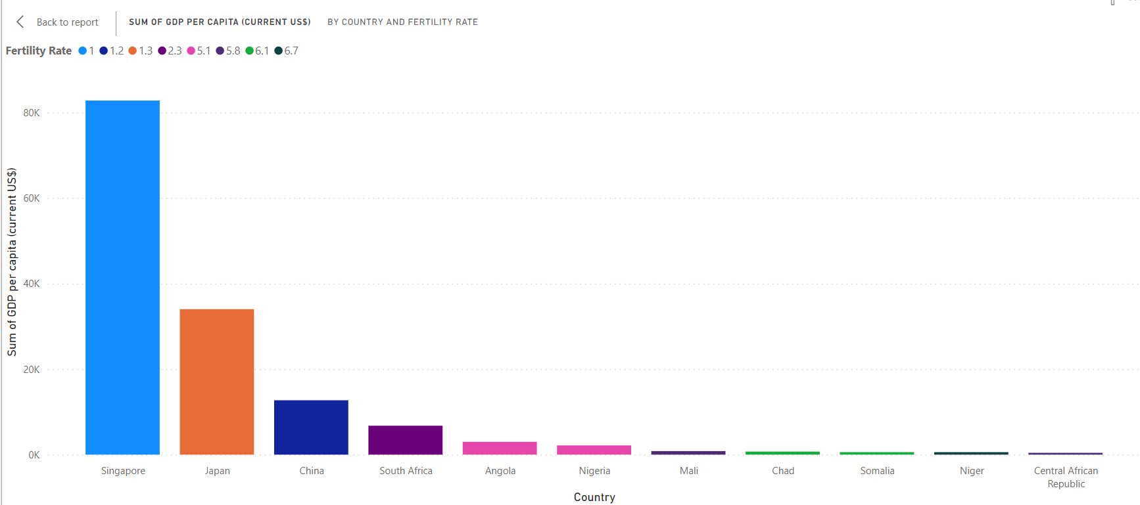
SUM OF GDP PER CAPITA (CURRENT US$) BY COUNTRY & FERTILITY RATE

Slide 8
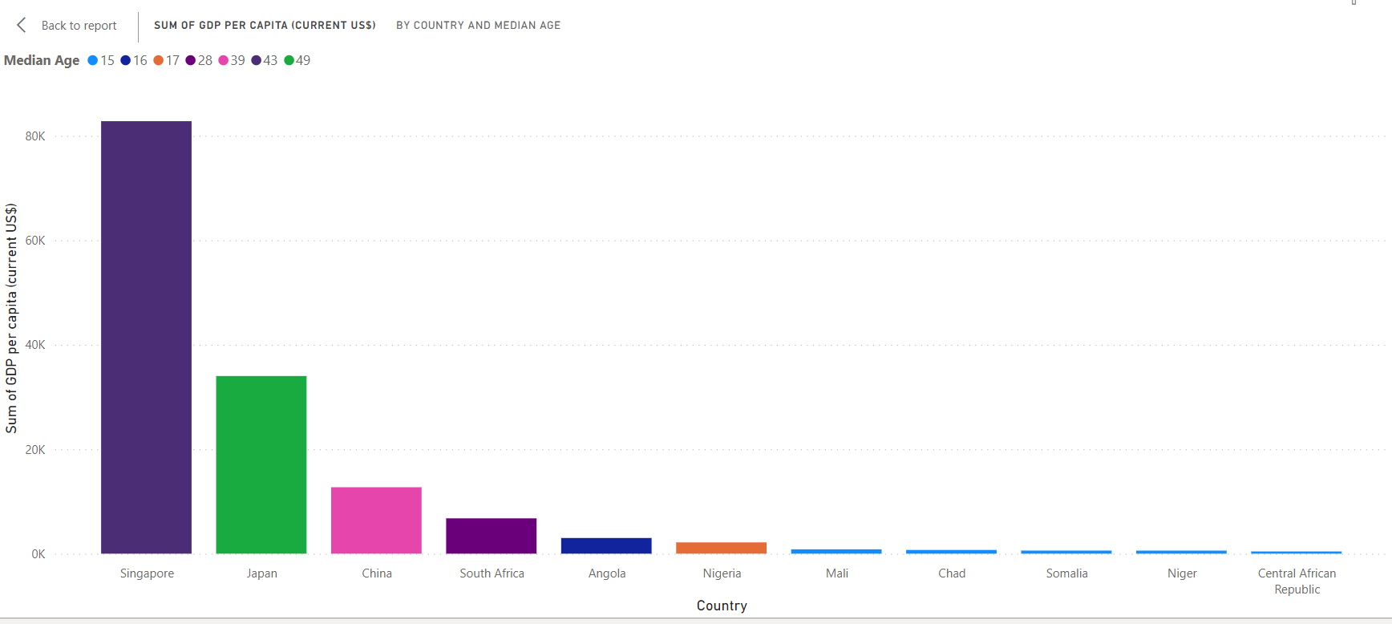
SUM OF GDP PER CAPITA (CURRENT US$) BY COUNTRY & MEDIAN AGE

Slide 9
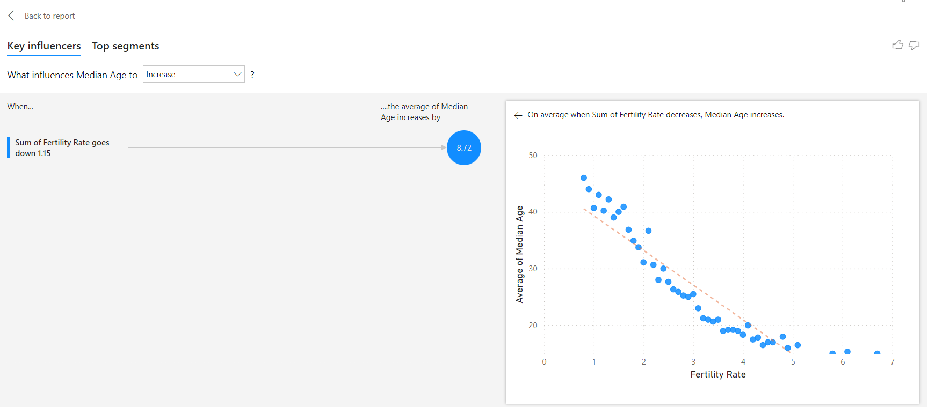
HOW FERTILITY RATE INFLUENCE MEDIAN AGE

Slide 10
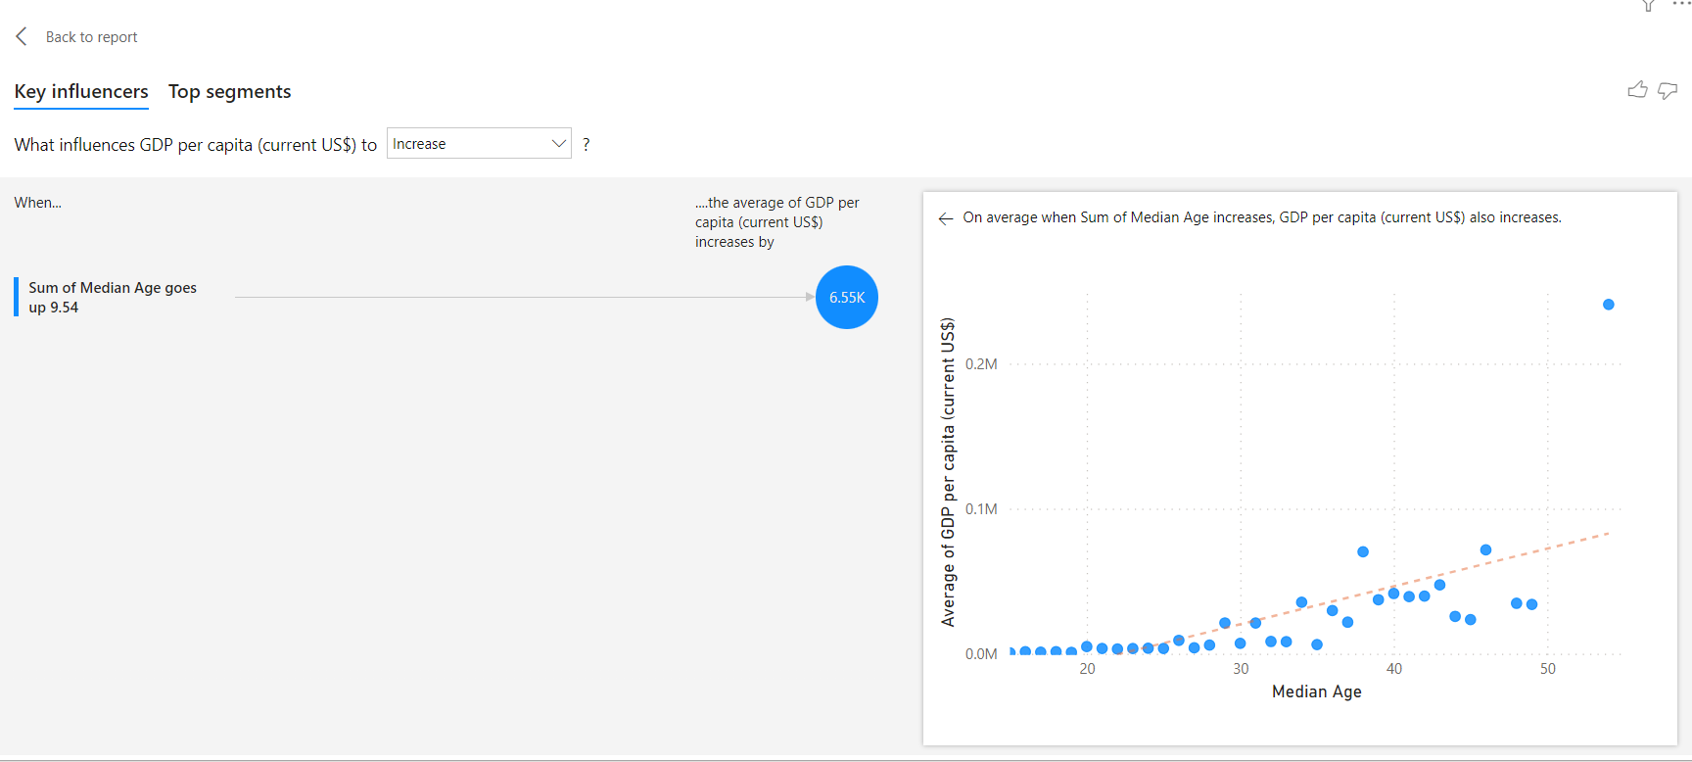
HOW MEDIAN AGE INFLUENCE GDP PER CAPITA (US$)

Slide 11
KEY INSIGHTS
WORLD
The global average Fertility Rate stands at 2.3, with a Median Age of 30.5 years and an average GDP Per Capita of $7738.88.
NIGERIA
At 5.10, Nigeria demonstrates a fertility rate exceeding the global average. Considering the established correlation between high fertility rates and lower median ages, it is unsurprising that Nigeria reports a median age below the global average, standing at 17, compared to the global median age of 30.5. This demographic characteristic undoubtedly impacts the country's GDP per capita, which currently stands at $2162.63, notably lower than the global average of $7738.88.
While Nigeria's GDP per capita is not the lowest worldwide, it falls significantly below the global average. However, through deliberate policy adjustments or restructuring, Nigeria has the potential to enhance its productivity levels and subsequently increase its GDP per capita.
COUNTRY | FERTILITY RATE | MEDIAN AGE | GDP PER CAPITA (US$)
Hong Kong | 0.8 | 46 | 48,983.62
South Korea | 0.9 | 44 | 32,422.57
Singapore | 1 | 43 | 82,807.62
Nigeria | 5.1 | 17 | 2,162.63
Somalia | 6.1 | 15 | 592.10
Niger | 6.7 | 15 | 585.40

Slide 12
RECOMMENDATIONS
In view of the fact that our analysis highlighted a positive correlation between low-average fertility rate & high GDP per capita (US$), a measured approach to reduction of Fertility Rate to help shore up the Median Age should be employed in Nigeria. To achieve this, we have the following recommendations for policy makers especially in the health and population control agencies:
Access to Contraception
Comprehensive Sex Education
Incentives & Disincentives
Population Awareness Campaigns
Our analysis also indicate that Nigeria currently have a youthful population, but at an age whereby they have little or no productive contribution to the country’s economy. If properly managed over the course of the next decade, this young demographic who would have grown into adulthood could positively drive an improvement in the country’s GDP per capita (US$). As a result of this, we have the following social and economic policy recommendations:
Encourage Entrepreneurship
Stable Policies that encourage Business Growth & Job Creation
Women Empowerment
Continuous Data Collection & Monitoring
Social Norms & Cultural Changes

Slide 13
REFERENCES/DATA SOURCES
https://energyeducation.ca/encyclopedia/World_population
https://www.investopedia.com/terms/p/per-capita-gdp.asp#:~:text=Gross%20domestic%20product%20per%20capita,compare%20it%20to%20other%20countries.
https://www.census.gov/glossary/?term=Median+age#:~:text=Definition,of%20the%20population%20is%20younger.
https://data.oecd.org/gdp/gross-domestic-product-gdp.htm#:~:text=Gross%20domestic%20product%20(GDP)%20is,and%20services%20(less%20imports).
https://databank.worldbank.org/metadataglossary/millennium-development-goals/series/SP.DYN.TFRT.IN
https://data.worldbank.org/indicator/NY.GDP.PCAP.CD

Slide 14
THANK YOU!

